Slide 1


SONAR BASED RADAR SYSTEM USING ARDUINO
ELECTRONICS AND COMMUNICATION ENGINEERING
Academic year: 2024-25 Semester: 6th
Course name: Mini project/ Electronic design workshop
Course code: ECE EC681
Presented by:
Sayan Bhattacharjee : 11500322043
Ritam Chakraborty : 11500322042
Abhishek Kumar Paswan: 11500322024
Debprasad Mallik: 11500322007

Slide 2
Index
1. PO Mapping
2. Objective
3. Introduction
4. Project workflow diagram
5. Circuit diagram and Hardware architecture
6. Electronic Components
7. System Workflow
8. Progress
9. Advantages and Technical Limitations of the System
10. Applications
11. Advantages and Limitations
12. Acknowledgement
13. Conclusion
14. References

Slide 3
PO/PSO MAPPED | LEVEL OF MAPPING | JUSTIFICATION
PO1 | 3 | The project applies mathematical concepts (such as distance calculation using the speed of sound), physics (sound wave reflection), and engineering principles (sensor integration and microcontroller programming) to build a functional radar system.
PO2 | 3 | The system involves identifying object detection challenges, formulating distance measurement techniques, analyzing signal reception errors, and refining the ultrasonic sensor’s accuracy using mathematical and scientific principles. .
PO3 | 3 | The project required designing a system that accurately detects objects and represents them visually, considering factors such as sensor placement, scanning angles, and real-time data processing.
PO4 | 3 | The project involved testing different sensor configurations, analyzing distance errors due to environmental factors, and optimizing data filtering to improve detection accuracy.
PO5 | 2 | Processing software was used for visualization, Arduino IDE for coding, and serial communication tools for data transmission, demonstrating the application of modern engineering tools.
PO6 | 3 | The radar system can be applied in security surveillance, automotive safety, and obstacle detection, addressing societal needs like accident prevention and automated monitoring.
PO7 | 2 | The project utilizes an energy-efficient ultrasonic sensor and microcontroller, demonstrating an understanding of resource-conscious engineering solutions that minimize environmental impact.
PO8 | 3 | The project adheres to ethical engineering practices, ensuring data accuracy and responsible use of technology in areas like security and automation.
PO9 | 3 | The project required collaboration among team members for hardware assembly, programming, and visualization, fostering teamwork in an interdisciplinary environment.
PO10 | 3 | Effective communication was essential for documenting system functionality, presenting findings, and troubleshooting software and hardware issues within the team.
PO11 | 2 | The project involved managing resources like sensors and microcontrollers within budget constraints and ensuring timely completion by following a structured development plan.
PO12 | 1 | The project introduced advanced concepts in sensor technology, data visualization, and microcontroller programming, encouraging continuous learning and skill development.
PSO1 | 3 | The project involves embedded system design (Arduino programming), real-time data processing, and communication between hardware and software (sensor data transfer and visualization).
PSO2 | 2 | The hands-on experience gained through this project prepares students for higher studies, research in radar and automation systems, and employment in embedded systems and communication engineering fields.

Slide 4
Objective
To design and implement a low-cost, Arduino-based radar system using an ultrasonic sensor and servo motor that can detect and visualize nearby objects by scanning across a defined angle range, with real-time data transmission for graphical representation—demonstrating the basic working principle of radar technology in embedded systems.

Slide 5
Introduction to Sonar Principles and Arduino Microcontroller Integration
Sonar (Sound Navigation and Ranging) is a powerful sensing technology that detects objects and measures distances using reflected sound waves. In this project, we integrate a sonar sensor with an Arduino microcontroller to develop a compact radar system, emphasizing its real-world applications across industries.
Using Arduino’s processing capabilities, the system can:
Enhance autonomous vehicles by detecting obstacles and preventing collisions.
Enable robotic precision, guiding robotic arms in object manipulation and safe navigation.
Support underwater exploration, mapping seabeds and locating marine life through sonar feedback.
Streamline industrial automation, where object tracking and distance measurement optimize manufacturing tasks.
This project demonstrates how affordable microcontroller-based sonar systems can be adapted for impactful technological applications in dynamic environments.

Slide 6
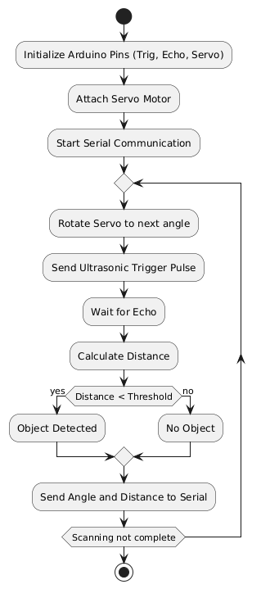
Project workflow diagram

Slide 7
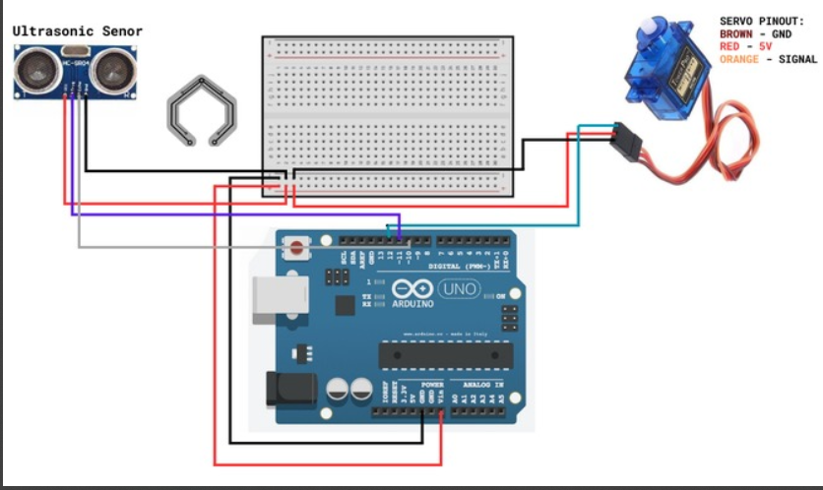
Ultrasonic Sensor
Breadboard
Servo motor
Circuit diagram
Arduino uno
Fig:SONAR BASED RADAR SYSTEM using ARDUINO

Slide 8

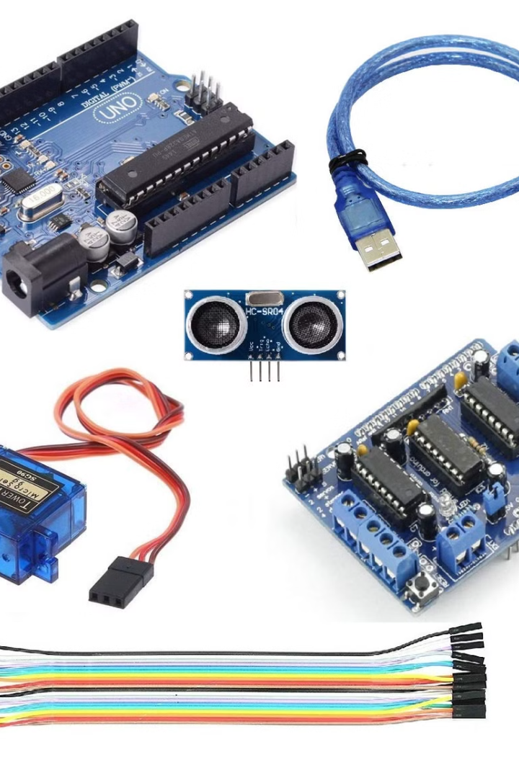
Essential Components
Arduino Uno
HC-SR04
The microcontroller brain for processing sensor data.
Ultrasonic sensor to measure distances.
Servo Motor (SG90)
Rotates the sensor for scanning.
Breadboard, Jumper Wires,
USB Cable (Type A to B)
Notes:
4

Slide 9

Detailed System Workflow: Signal Transmission and Reception
Signal Transmission
The sonar sensor emits ultrasonic sound waves at a specific frequency.
Signal Reception
The sonar sensor receives the reflected sound waves.
1
2
3
4
Signal Reflection
Distance Calculation
The emitted sound waves travel through the air and reflect back when they encounter an object.
The Arduino microcontroller calculates the distance to the object by measuring the time taken for the sound waves to travel to the object and back.

Slide 10
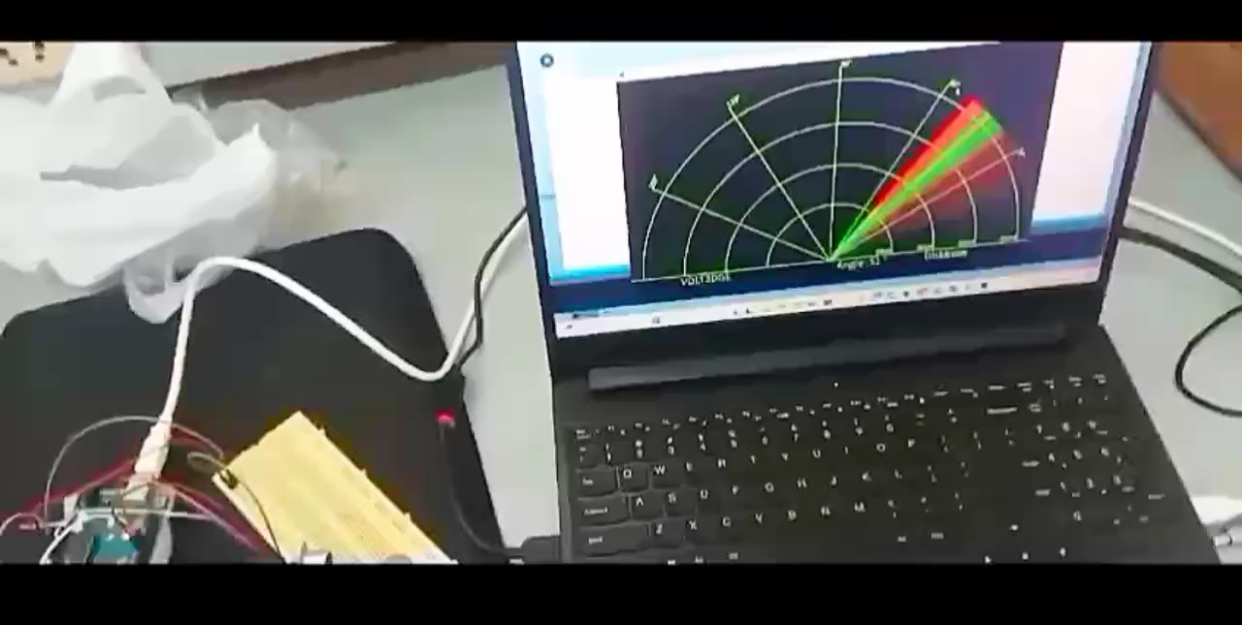
Progress

Slide 11
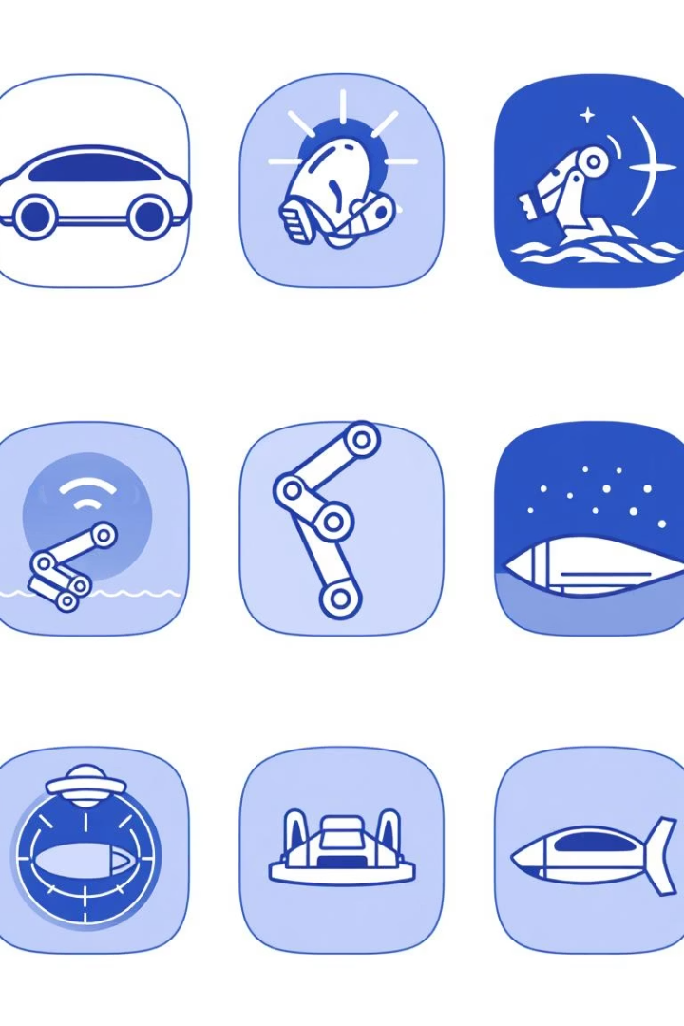




Practical and Emerging Applications in Various Industries
Autonomous Vehicles
Sonar radar systems can be used for obstacle detection and collision avoidance in autonomous vehicles.
Robotics
They can be implemented in robotic arms for precise object manipulation and navigation.
Underwater Exploration
Sonar systems are extensively used in underwater exploration for mapping seabeds, detecting marine life, and locating objects.
Industrial Automation
Sonar radar can be integrated into automated systems for tasks like object tracking and distance measurement in manufacturing processes.

Slide 12
Comparative Advantages and Technical Limitations of the System
Advantages
Limitations
Low cost
Limited range
Relatively simple to implement
Susceptible to interference
Suitable for various applications
Accuracy can be affected by environmental factors
Effective in both air and water
Not suitable for detecting small or soft objects

Slide 13

Acknowledgment
We would like to express our sincere gratitude to everyone who contributed to the successful completion of our project on SONAR-Based Radar System Using Arduino.
Firstly, we extend our heartfelt thanks to our mentor
Dr. Madhumita sarkar & Mr. Pushpendu Kanjilal
for their invaluable guidance, continuous support, and insightful suggestions throughout this project. Their expertise and encouragement have been instrumental in shaping our understanding and execution of the project.
We would also like to thank our institution/college B.P. Poddar Institute of Management & Technology for providing us with the necessary resources and a conducive learning environment to explore and implement this technology.
Furthermore, we are grateful to our friends, peers, and family members for their constant motivation and encouragement, which kept us focused and determined to complete this work successfully.
Finally, we acknowledge the authors of various research papers, online tutorials, and open-source communities whose resources helped us gain knowledge and refine our approach to this project.
Thank you all for your support and guidance!

Slide 14

Conclusion
Utilizes ultrasonic waves to detect nearby objects and measure distances accurately.
Built using Arduino, making it budget-friendly and accessible for beginners.
Suitable for applications like obstacle detection, security, and automation.
Highlights Arduino’s capability as a learning platform for embedded systems and electronics.

Slide 15
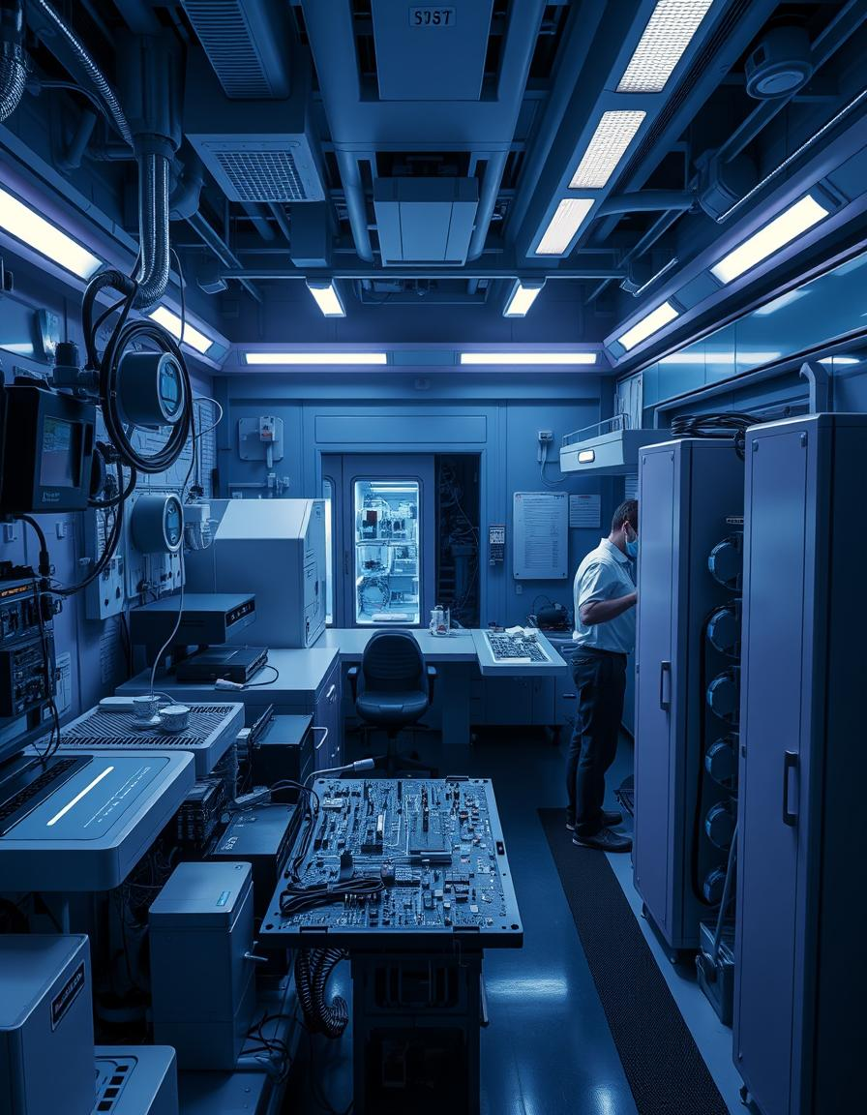
References
Arduino Official Website – https://www.arduino.cc/
Servo Motor Basics – https://www.robotshop.com/community/tutorials/show/servo-motor-basics
Radar and Sonar Technology Overview – https://www.sciencedirect.com/topics/engineering/sonar-systems
HC-SR04 Ultrasonic Sensor Datasheet – https://components101.com/ultrasonic-sensor-working-pinout-datasheet
Arduino-Based Radar Project Guide – https://create.arduino.cc/projecthub

Slide 16
THANK YOU

